Slide 1
JSP - Lifecycle
Shakti Prakash
Asstt. Prof. Computer Applications
Govt. Degree College Anantnag
5th SEMESTER CORE – 11 BCA516C1: INTERNET TECHNOLOGIES

Slide 2
Paths Followed By JSP
The following are the paths followed by a JSP
Compilation
Initialization
Execution
Cleanup

Slide 3
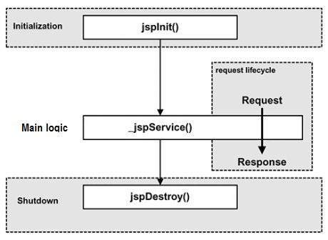
The four major phases of a JSP life Cycle

Slide 4
1. JSP Compilation
When a browser asks for a JSP, the JSP engine first checks to see whether it needs to compile the page. If the page has never been compiled, or if the JSP has been modified since it was last compiled, the JSP engine compiles the page.
The compilation process involves three steps −
Parsing the JSP.
Turning the JSP into a servlet.
Compiling the servlet.

Slide 5
2. JSP Initialization
When a container loads a JSP it invokes the jspInit() method before servicing any requests.
If you need to perform JSP-specific initialization, override the jspInit() method −
public void jspInit()
{ // Initialization code... }
Typically, initialization is performed only once and as with the servlet init method, you generally initialize database connections, open files, and create lookup tables in the jspInit method.

Slide 6
3. JSP Execution
This phase of the JSP life cycle represents all interactions with requests until the JSP is destroyed.
Whenever a browser requests a JSP and the page has been loaded and initialized, the JSP engine invokes the _jspService() method in the JSP.
The _jspService() method takes an HttpServletRequest and an HttpServletResponse as its parameters as follows −
void _jspService(HttpServletRequest request, HttpServletResponse response)
{ // Service handling code... }
The _jspService() method of a JSP is invoked on request basis. This is responsible for generating the response for that request and this method is also responsible for generating responses to all seven of the HTTP methods, i.e, GET, POST, DELETE, etc.

Slide 7
4. JSP Cleanup
The destruction phase of the JSP life cycle represents when a JSP is being removed from use by a container.
The jspDestroy() method is the JSP equivalent of the destroy method for servlets. Override jspDestroy when you need to perform any cleanup, such as releasing database connections or closing open files.
The jspDestroy() method has the following form −
public void jspDestroy()
{ // Your cleanup code goes here. }

